Slide 1
How can we use generative AI to provide feedback to teacher trainees?

Slide 2
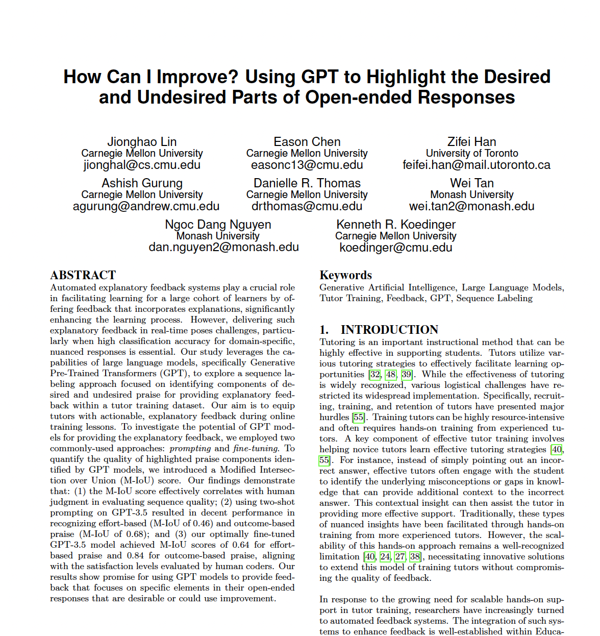
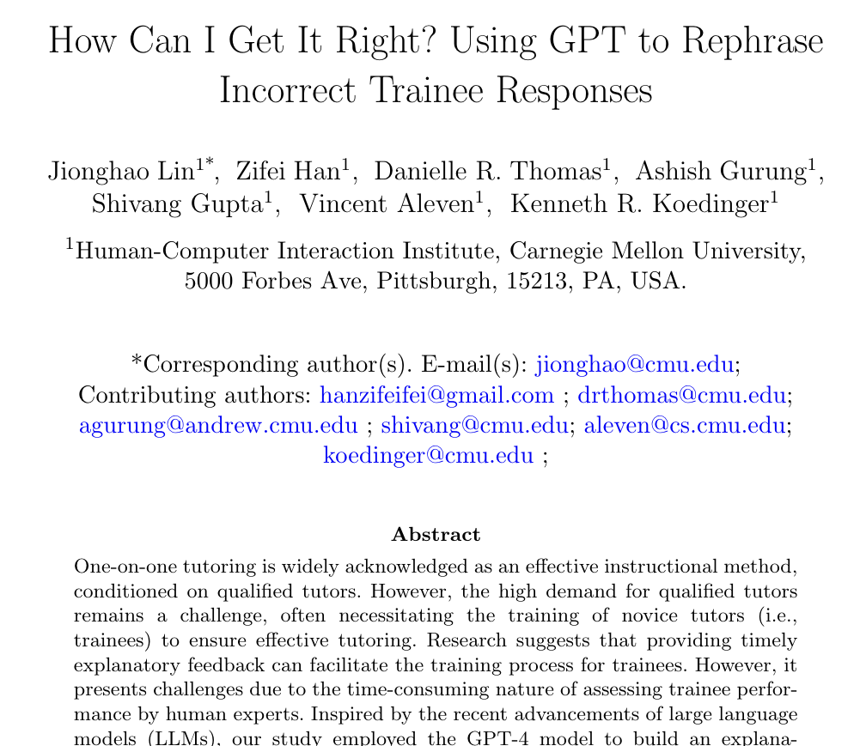
Lin, J., Chen, E., Han, F., Gurung, A., Thomas, D. R., Tan, W., Ngoc, D. N., & Koedinger, K. R. (2024). How Can I Improve? Using GPT to Highlight the Desired and Undesired Parts of Open-ended Responses. 17th International Conference on Educational Data Mining (Accepted)
Lin, J., Han, Z., Thomas, D. R., Gurung, A., Gupta, S., Aleven, V., & Koedinger, K. R. (2024). How Can I Get It Right? Using GPT to Rephrase Incorrect Trainee Responses. International Journal of Artificial Intelligence in Education (Accepted)

Slide 3





PLUS is a platform designed to optimize tutoring
Our mission is to double math learning for 10,000 students by 2026
Personalized Learning Squared (PLUS)
Kenneth R. Koedinger
(Principal Investigator)
Vincent Aleven
(Co-Principal Investigator)

Slide 4
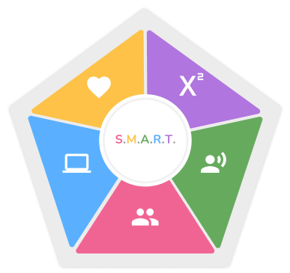
PLUS Tutor Training
SMART Competencies Framework:
Social Emotional Learning
Mastering Content
Advocacy
Relationships
Technology Tools
Both asynchronous and synchronous training options are available
Thomas, D., Yang, X., Gupta, S., Adeniran, A., Mclaughlin, E., & Koedinger, K. (2023, March). When the tutor becomes the student: Design and evaluation of efficient scenario-based lessons for tutors. In LAK23: 13th International Learning Analytics and Knowledge Conference (pp. 250-261).

Slide 5
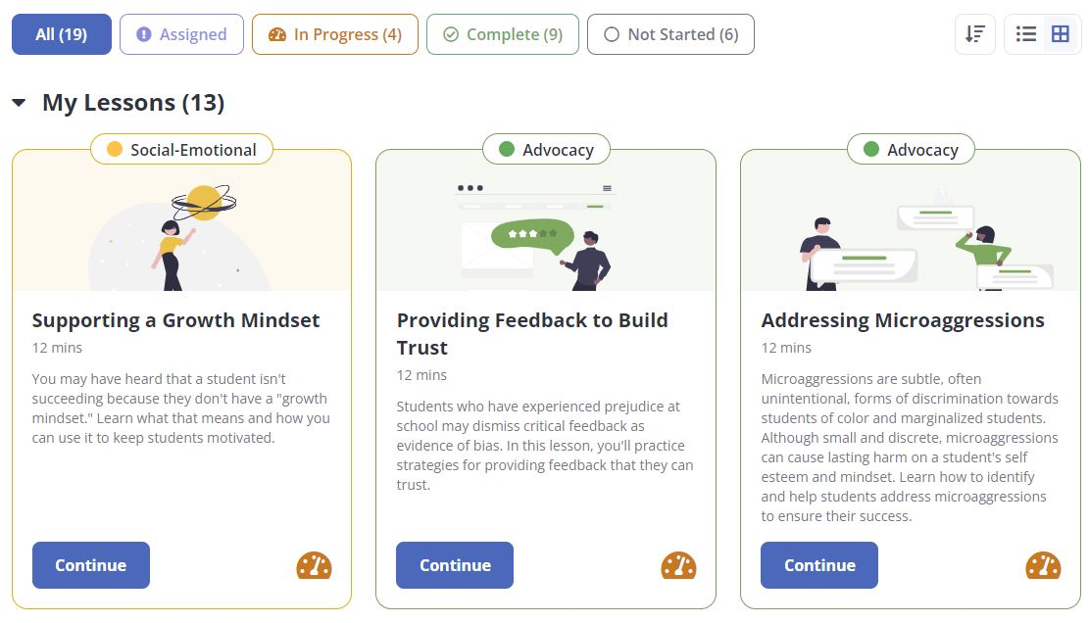
Lessons in the PLUS app
Thomas, D., Yang, X., Gupta, S., Adeniran, A., Mclaughlin, E., & Koedinger, K. (2023, March). When the tutor becomes the student: Design and evaluation of efficient scenario-based lessons for tutors. In LAK23: 13th International Learning Analytics and Knowledge Conference (pp. 250-261).

Slide 6
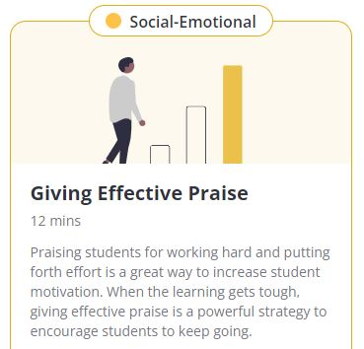
Effective Praise
Train novice tutors (adult learners) to give effective praise for middle school students.
Effective Praise should be:
perceived as sincere, earned, and truthful.
specific by detailing what the student did well, not generic (e.g., “great job” ).
focused on the student learning process
Thomas, D., Yang, X., Gupta, S., Adeniran, A., Mclaughlin, E., & Koedinger, K. (2023, March). When the tutor becomes the student: Design and evaluation of efficient scenario-based lessons for tutors. In LAK23: 13th International Learning Analytics and Knowledge Conference (pp. 250-261).

Slide 7
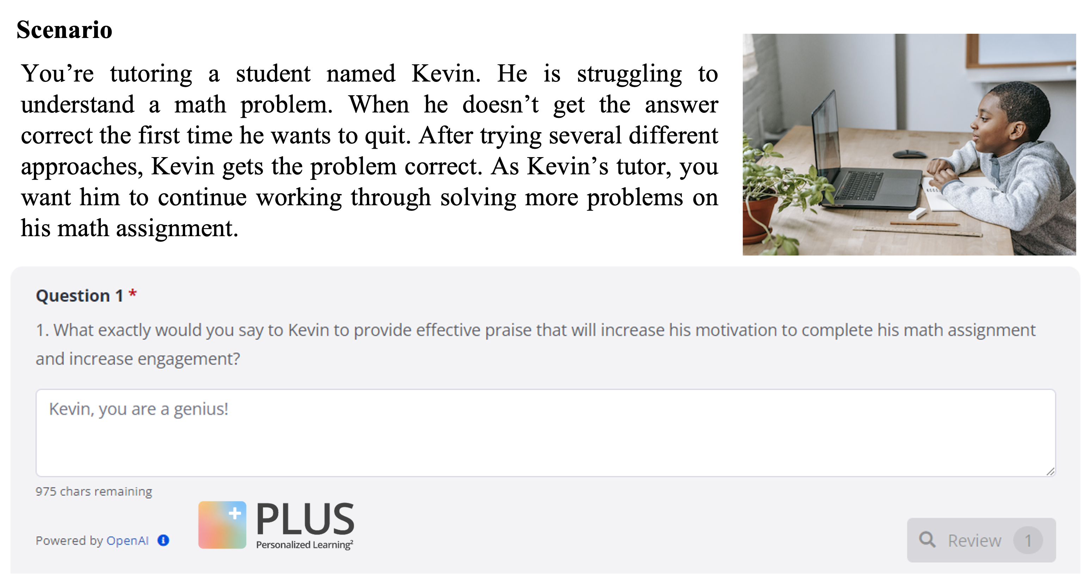
Scenario-based Question
Question scenario

Slide 8
Scenario-based Question
Question for learner

Slide 9
Scenario-based Question
Learner’s attempt

Slide 10
Examples of Tutor Responses
129 tutor responses from the Lesson Giving Effective Praise
Examples of tutor responses:
“Well done!”
“Good effort working through this.”
“You did it, you did well, you got the right answer and you stuck with it, I'm proud of what you have done.”

Slide 11
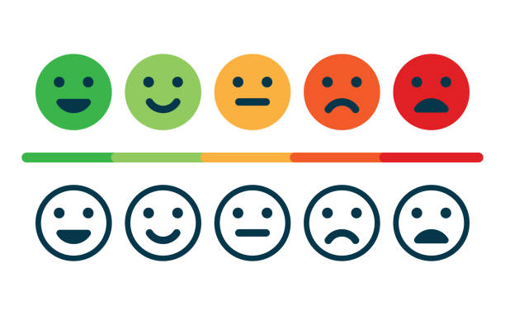
Praise Types
Effort-based praise: focus on the learning process (e.g., “I like how you worked hard to…”).
Thomas, D., Yang, X., Gupta, S., Adeniran, A., Mclaughlin, E., & Koedinger, K. (2023, March). When the tutor becomes the student: Design and evaluation of efficient scenario-based lessons for tutors. In LAK23: 13th International Learning Analytics and Knowledge Conference (pp. 250-261).

Slide 12
Praise Types
Effort-based praise: focus on the learning process (e.g., “I like how you worked hard to…”). Outcome-based praise: focus on student's achievements, such as getting an A on an assignment or getting a problem correct, and is often, but not always, associated with unproductive praise (e.g., “Great job!”).
Thomas, D., Yang, X., Gupta, S., Adeniran, A., Mclaughlin, E., & Koedinger, K. (2023, March). When the tutor becomes the student: Design and evaluation of efficient scenario-based lessons for tutors. In LAK23: 13th International Learning Analytics and Knowledge Conference (pp. 250-261).

Slide 13
Praise Types
Effort-based praise: focus on the learning process (e.g., “I like how you worked hard to…”). Outcome-based praise: focus on student's achievements, such as getting an A on an assignment or getting a problem correct, and is often, but not always, associated with unproductive praise (e.g., “Great job!”).
Automated feedback on trainee responses to open-ended questions
Thomas, D., Yang, X., Gupta, S., Adeniran, A., Mclaughlin, E., & Koedinger, K. (2023, March). When the tutor becomes the student: Design and evaluation of efficient scenario-based lessons for tutors. In LAK23: 13th International Learning Analytics and Knowledge Conference (pp. 250-261).

Slide 14
Provide feedback on trainee tutor responses
Highlights:
Developed an automated feedback, which can highlight the desired and undesired components from trainees’ responses
Proposed a metric to measure the quality of highlighted components identified by GPT models
Lin, J., Chen, E., Han, F., Gurung, A., Thomas, D. R., Tan, W., Ngoc, D. N., & Koedinger, K. R. (2024). How Can I Improve? Using GPT to Highlight the Desired and Undesired Parts of Open-ended Responses. 17th International Conference on Educational Data Mining (Accepted)

Slide 15
Provide feedback on trainee tutor responses
Effort-based praise Outcome-based praise
Trainee tutor: “Well done, Kevin! Let’s work on the next one”

Slide 16
Provide feedback on trainee tutor responses
Effort-based praise Outcome-based praise
Trainee tutor: “Well done, Kevin! Let’s work on the next one”
Feedback for the trainee tutor:
Saying “Well done” is praising students for the outcome. You should focus on praising the students for their effort and process towards learning. Do you want to try responding again?

Slide 17
Provide feedback on trainee tutor responses
Effort-based praise Outcome-based praise
Trainee tutor: “Good effort working through this, let’s move to the next problem.”

Slide 18
Provide feedback on trainee tutor responses
Effort-based praise Outcome-based praise
Trainee tutor: “Good effort working through this, let’s move to the next problem.”
Feedback for the trainee tutor:
Saying “Good effort working through this” is a nice example of effort-based praise, which praises students for their effort.

Slide 19
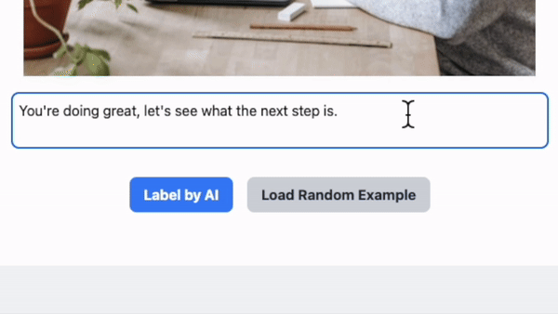
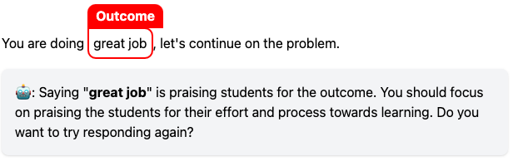
Provide feedback on trainee tutor responses
Fine-tuned GPT-3.5 for highlighting key components on novice tutors’ responses
Lin, J., Chen, E., Han, F., Gurung, A., Thomas, D. R., Tan, W., Ngoc, D. N., & Koedinger, K. R. (2024). How Can I Improve? Using GPT to Highlight the Desired and Undesired Parts of Open-ended Responses. 17th International Conference on Educational Data Mining (Accepted)

Slide 20
Provide feedback on trainee tutor responses
We invite human coders to rate the accuracy of highlighted components by educational expert and by GPT-3.5
Human coders rate expert’s highlight as accurate about 80% of the time and they rate GPT-3.5 as accurate about 65% of the time.
Lin, J., Chen, E., Han, F., Gurung, A., Thomas, D. R., Tan, W., Ngoc, D. N., & Koedinger, K. R. (2024). How Can I Improve? Using GPT to Highlight the Desired and Undesired Parts of Open-ended Responses. 17th International Conference on Educational Data Mining (Accepted)

Slide 21
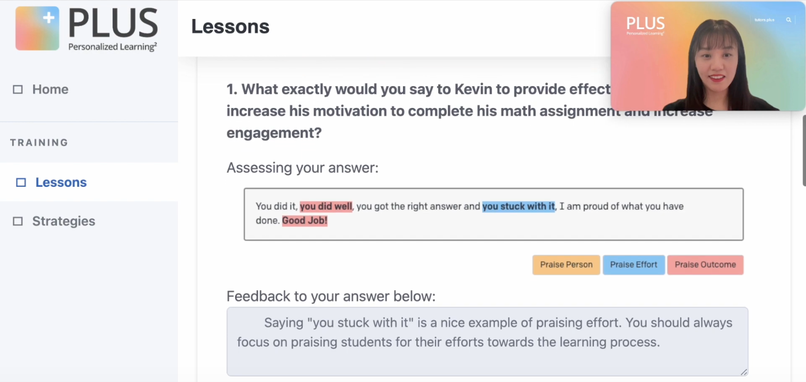

Provide feedback on trainee tutor responses
🏆 Lin, J., Thomas, D.R., Han, Z., Tan, W., Nguyen, N.D., Gupta, S., Gatz, E., Tipper, C. & Koedinger, K.R. (2023). Personalized Learning Squared (PLUS): Doubling Math Learning through AI-assisted Tutoring. AIED23 Interactive Demo - The 24th International Conference on Artificial Intelligence in Education.

Slide 22
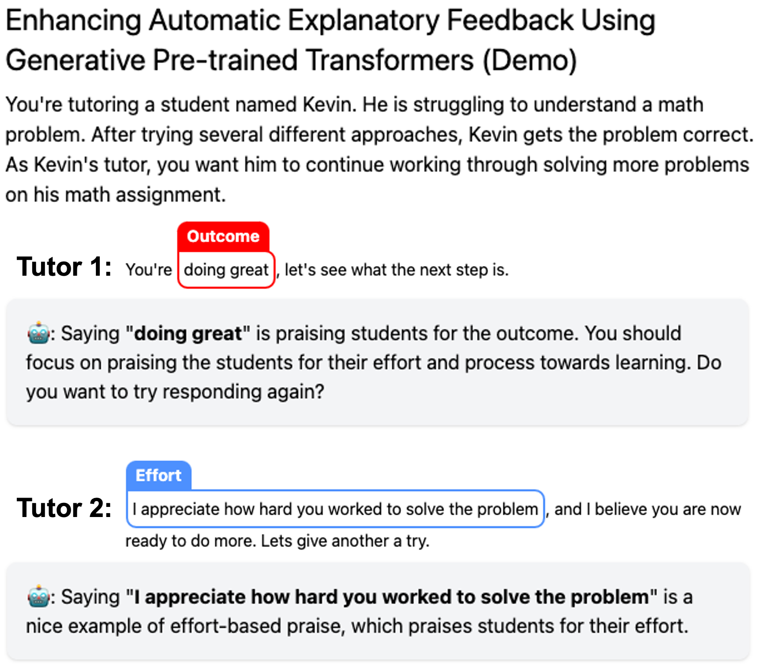
Trainees: Where am I wrong and how can I improve?
Lin, J., Chen, E., Han, F., Gurung, A., Thomas, D. R., Tan, W., Ngoc, D. N., & Koedinger, K. R. (2024). How Can I Improve? Using GPT to Highlight the Desired and Undesired Parts of Open-ended Responses. 17th International Conference on Educational Data Mining (Accepted)

Slide 23
Trainees: How Can I Get It Right?
Lin, J., Han, Z., Thomas, D. R., Gurung, A., Gupta, S., Aleven, V., & Koedinger, K. R. (2024). How Can I Get It Right? Using GPT to Rephrase Incorrect Trainee Responses. International Journal of Artificial Intelligence in Education (Accepted)

Slide 24
Trainees: How Can I Get It Right?
Lin, J., Han, Z., Thomas, D. R., Gurung, A., Gupta, S., Aleven, V., & Koedinger, K. R. (2024). How Can I Get It Right? Using GPT to Rephrase Incorrect Trainee Responses. International Journal of Artificial Intelligence in Education (Accepted)

Slide 25
Highlights:
Developed an automated feedback, which can predict the correctness of trainees’ responses.
The undesired responses can be further rephrased into the desired forms by GPT models
Lin, J., Han, Z., Thomas, D. R., Gurung, A., Gupta, S., Aleven, V., & Koedinger, K. R. (2024). How Can I Get It Right? Using GPT to Rephrase Incorrect Trainee Responses. International Journal of Artificial Intelligence in Education (Accepted).

Slide 26
Prompted GPT-4 for rephrasing incorrect responses into correct form
Trainees: Where am I wrong and how can I improve?
Lin, J., Han, Z., Thomas, D. R., Gurung, A., Gupta, S., Aleven, V., & Koedinger, K. R. (2024). How Can I Get It Right? Using GPT to Rephrase Incorrect Trainee Responses. International Journal of Artificial Intelligence in Education (Accepted).

Slide 27
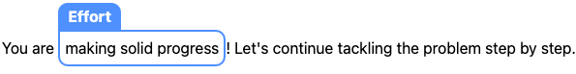
Prompted GPT-4 for rephrasing incorrect responses into correct form
AI has rephrased your response and suggests a possible improvement by recommending the following instead.
Trainees: Where am I wrong and how can I improve?
Trainees: How Can I Get It Right?
Lin, J., Han, Z., Thomas, D. R., Gurung, A., Gupta, S., Aleven, V., & Koedinger, K. R. (2024). How Can I Get It Right? Using GPT to Rephrase Incorrect Trainee Responses. International Journal of Artificial Intelligence in Education (Accepted).

Slide 28



Using GPT to Rephrase Incorrect Trainee Responses
Lin, J., Han, Z., Thomas, D. R., Gurung, A., Gupta, S., Aleven, V., & Koedinger, K. R. (2024). How Can I Get It Right? Using GPT to Rephrase Incorrect Trainee Responses. International Journal of Artificial Intelligence in Education (Accepted)

